Slide 1

CIS [7CS9281]
Alliance School of Advanced Computing
Project Title: Automated Student Performance Prediction
Batch : 2023 - 2027
Semister End Examination
Project No: 36
Presented by
Student Name Branch Reg No
Chalini M CSE-AIML 2023BCSE07AED440
Spandana Basava Kulal CSE-AIML 2023BCSE07AED441
Name of the Mentor: Prof. J Jesy Janet Kumari
Date of Exam: 13-11-2026

Slide 2

Outline
Project Overview
Literature Review
Problem Statement and Research Gap
System Requirements and Architecture
Proposed Methodology and Implementation
Results, Testing and Discussion
Conclusion and Future Enhancements
References

Slide 3
I. Project Overview
Problem Context – Traditional student assessment mainly relies on examination marks and manual evaluation. Identifying students who may be at risk of poor academic performance at an early stage is challenging.
Motivation – To develop an AutoML-based system that predicts student academic performance by automating data preprocessing, model selection, and hyperparameter optimization.
Significance – Helps identify academically at-risk students, compares multiple machine learning algorithms, and supports timely academic intervention and data-driven decisions.
Application Domain – Educational Data Mining / Machine Learning in Education / Academic Risk Prediction.
Target Users – Teachers, educational institutions, academic researchers, and students.

Slide 4
III. Literature Review
Author Name, Paper Name Journal/Conference, Year | Research / Methodology | Dataset Used | Performance Metrics | Advantages | Disadvantages
1. P. Umamaheswari et al. (2024) – Student Performance Prediction Using Modified SVM and KNN | Modified SVM, KNN | Student data | Accuracy, Recall, F1-score | Supports student success prediction | No automated model selection.
2. Snehal Paddalwar et al. (2022) – Machine Learning Algorithms with Hybrid Feature Selection | ML with Hybrid Feature Selection | Classroom and academic data | Not specified | Improves feature selection | Depends on data quality
3. Teodor Sakal Franciskovic et al. (2024) – Predicting Final Exam Scores from Regularity of Pre-Class Activity | ML, Regression, Clustering | Flipped-classroom activity data | Not specified | Uses student engagement patterns | Limited generalization

Slide 5
4. Hend Alrasheed et al. (2021) – English Proficiency and Academic Performance of Software Engineering Students | Statistical and Correlation Analysis | English proficiency and academic data | Not specified | Identifies relevant academic factors | Focuses mainly on English proficiency
5. Mohanad Sobhy Sallam et al. (2026) – Student Adaptability Prediction Using Machine Learning and XAI | ML with XAI | Student adaptability data | Not specified | Improves prediction interpretability | Limited focus on academic grades
6. V. Balasubramanian et al. (2024) – Machine Learning Framework for Predicting Academic Outcome Using SVM and XGBoost | SVM, XGBoost | Educational data | Not specified | Provides ML model comparison | No complete AutoML pipeline

Slide 6
7. Bavani Raja Pandian et al. (2024) – Machine Learning Techniques for Student Performance Forecasting | Review of ML techniques | Multiple educational studies | Not specified | Identifies major prediction challenges | No implemented prediction framework
8. Zhiyi Xu (2024) – Educational Data Analytics and Machine Learning Applications in Student Learning Analytics | AI/ML and Learning Analytics | Educational data | Not specified | Supports data-driven education | No dedicated AutoML framework.
9. Brijesh Kumar Verma et al. (2025) – Clustering-Guided Data Mining for Hybrid Learning Outcomes | Clustering and Data Mining | Hybrid-learning data | Not specified | Identifies student learning patterns. | Limited automated prediction

Slide 7
III. Problem Statement and Research Gap
Problem Statement – Existing student performance prediction approaches often depend on individual machine learning algorithms and manual model selection, making the prediction process time-consuming and less efficient.
Limited Automation – Many existing approaches do not automate the complete process of data preprocessing, feature transformation, model selection, and hyperparameter optimization.
Model Selection –Different algorithms may produce different prediction results, making it difficult to identify the most suitable model manually.
Proposed Solution – Our project addresses this gap by developing an AutoML-based framework using five algorithms, Optuna optimization, and two prediction scenarios: Early Prediction and Grade-Assisted Prediction.

Slide 8
IV. System Requirements and Architecture
Hardware Requirements – Computer/laptop with Intel Core i5 or equivalent processor, minimum 8 GB RAM, and sufficient storage for dataset processing and model training.
Software Requirements – Python, Jupyter Notebook/Google Colab, Pandas, NumPy, Scikit-learn, XGBoost, Optuna, Matplotlib, Seaborn, and Streamlit.
Dataset / Resource Requirements – UCI Student Performance datasets (Mathematics and Portuguese), containing student demographic, social, and academic attributes, including G1, G2, and G3 grades.
Constraints – Limited dataset size, class imbalance, dependency on input data quality, lower prediction performance in Early Prediction due to the absence of previous examination grades, and the need for reliable model evaluation.

Slide 9
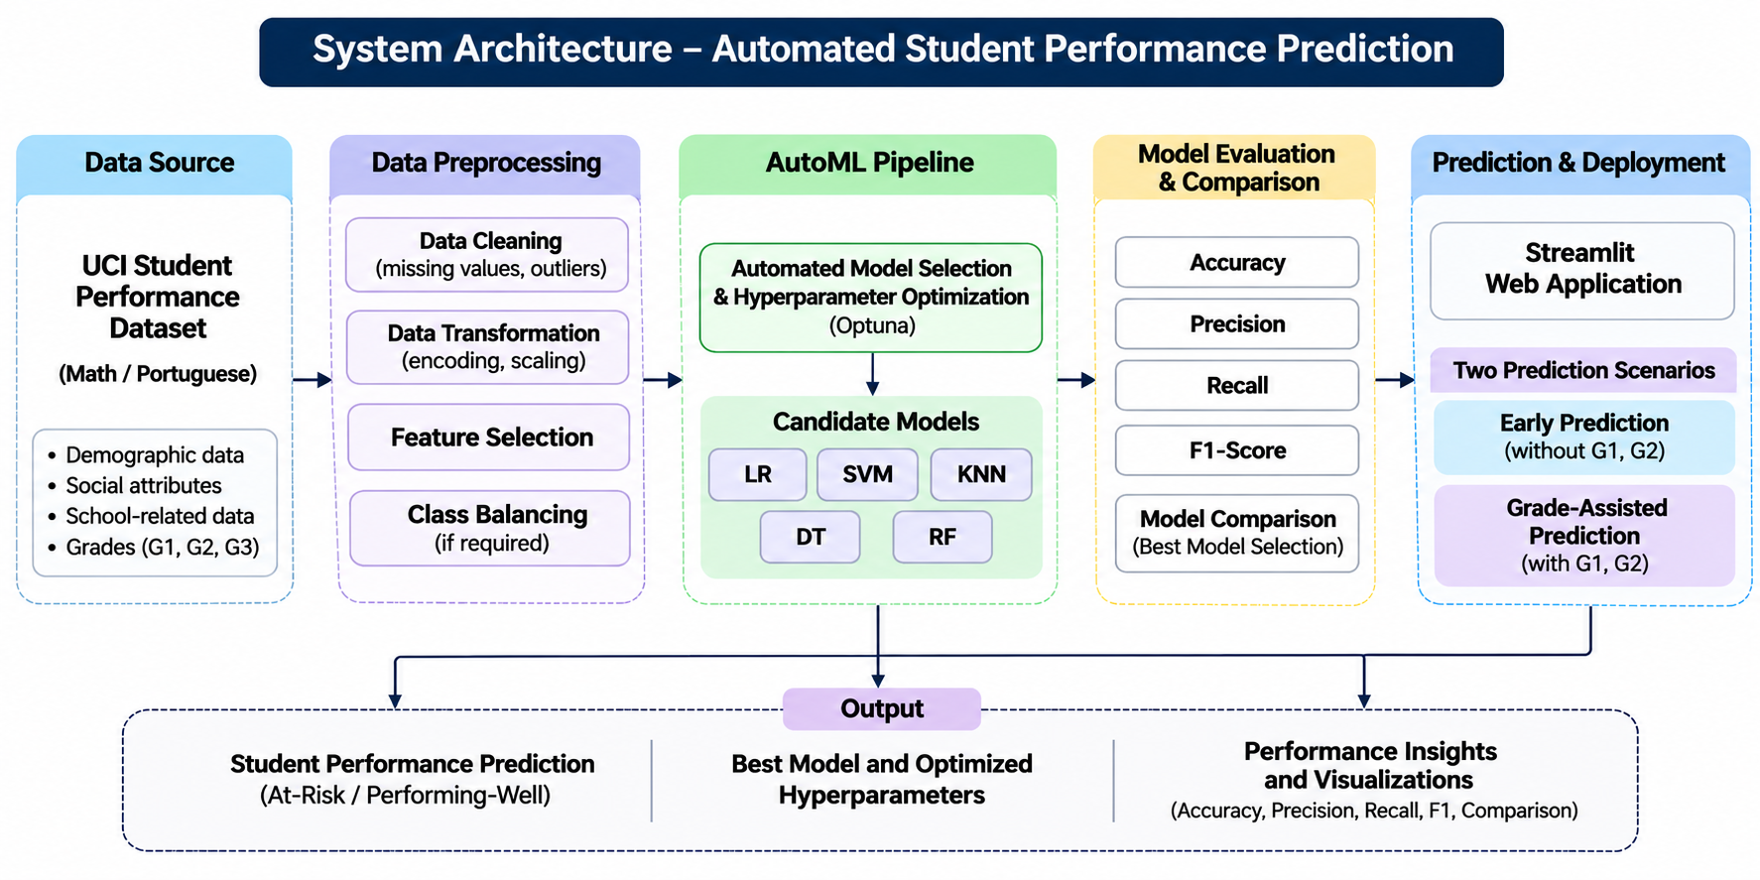
System Architecture

Slide 10
V. Proposed Methodology and Implementation
Data Collection – Use UCI Student Performance datasets for Mathematics and Portuguese subjects.
Data Preprocessing – Perform data validation, categorical encoding, feature transformation, and scaling.
Scenario Preparation – Develop two prediction scenarios: Early Prediction and Grade-Assisted Prediction.
Model Development – Implement five machine learning algorithms: Logistic Regression, Decision Tree, Random Forest, SVM, and XGBoost.
Hyperparameter Optimization – Apply Optuna to automatically identify suitable model parameters.
Model Evaluation – Evaluate models using Accuracy, Precision, Recall, F1-score, Macro-F1, and Balanced Accuracy.

Slide 11
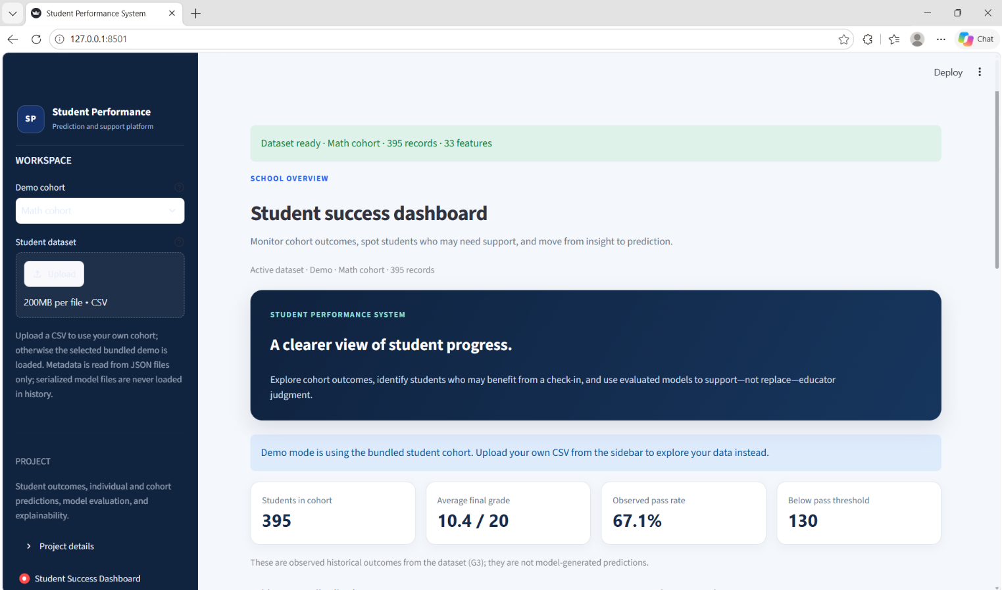
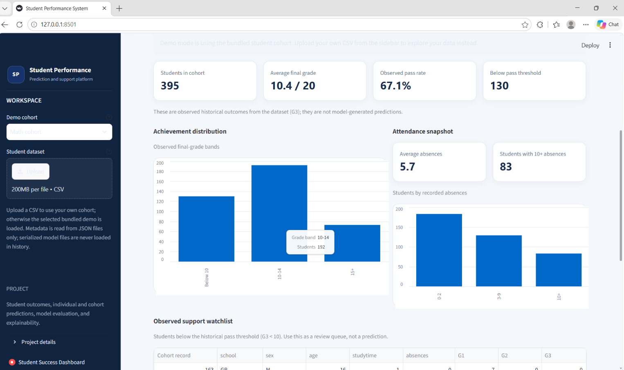
Implementation
Develop an interactive Streamlit dashboard to display student predictions, model comparisons, and performance visualizations.

Slide 12
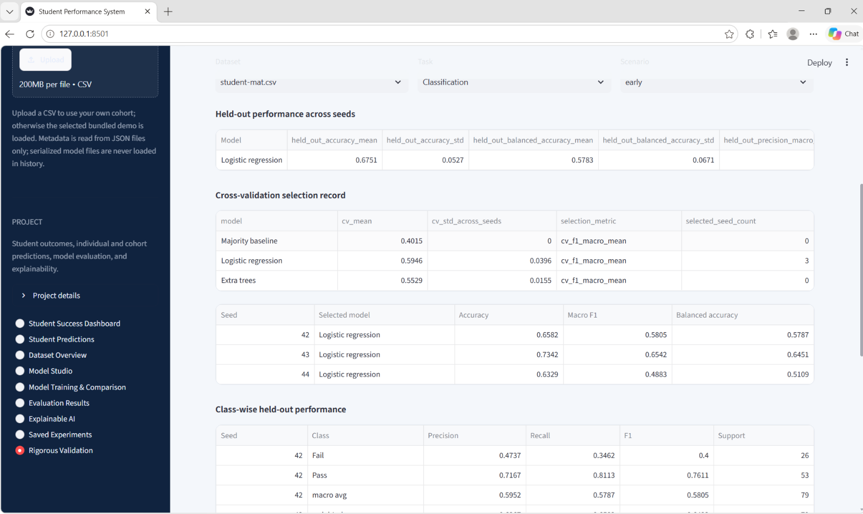

Slide 13
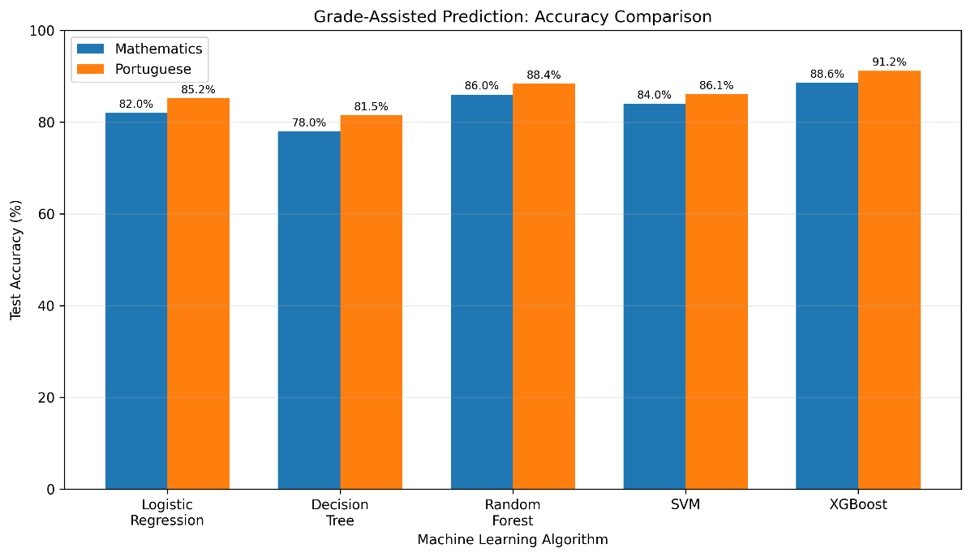
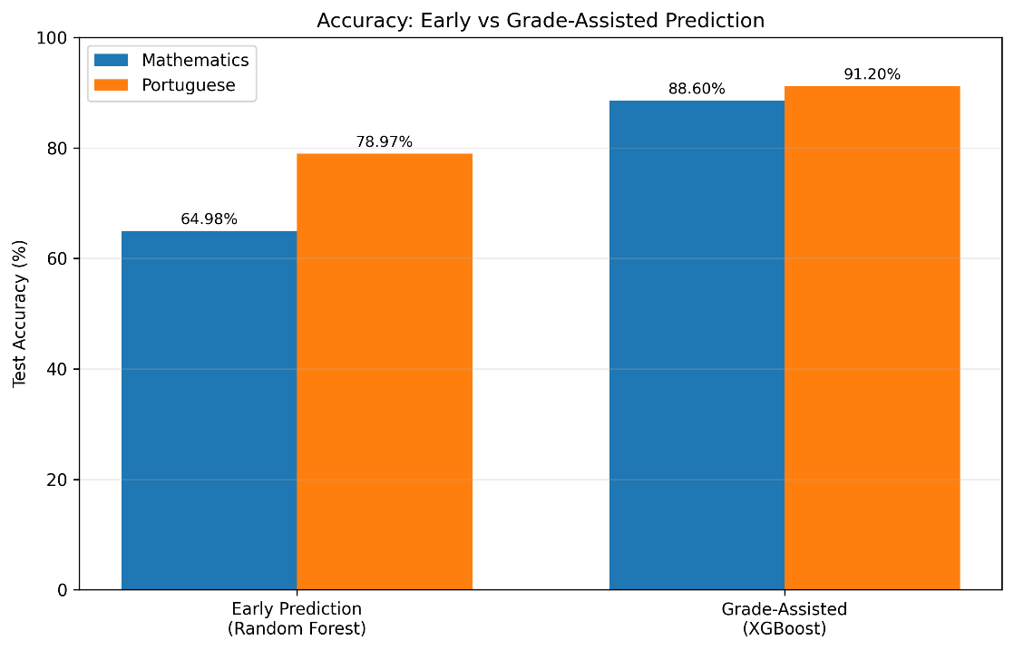
VI. Results, Testing and Discussion
Results:
Fig 1. Accuracy Comparison Graph
Fig 2. Early vs Grade-Assisted Prediction Graph

Slide 14
Testing – The framework was evaluated using training and testing data, stratified cross-validation, and multiple performance metrics.
Discussion – The results demonstrate that previous academic grades significantly improve prediction performance, while Early Prediction provides an opportunity for earlier academic intervention.

Slide 15
VII. Conclusion and Future Enhancement
Conclusion
The proposed system successfully demonstrates an AutoML-based approach for predicting student academic performance. It automates data preprocessing, model selection, and hyperparameter optimization while comparing five machine learning algorithms across two prediction scenarios. The results show that Grade-Assisted Prediction improves performance, helping educational institutions identify students who may need additional academic support.
Future Enhancement
Include attendance, assignment scores, and learning activity data
Explore advanced machine learning and deep learning algorithms
Provide personalized academic recommendations
Deploy the application on a cloud platform for wider accessibility

Slide 16
VIII.References
Research Papers:
P. Umamaheswari et al., 2024 – Student Performance Prediction
Snehal Paddalwar et al., 2022 – Machine Learning with Hybrid Feature Selection
Teodor Sakal Franciskovic et al., 2024 – Student Performance Prediction in Flipped Classrooms
Hend Alrasheed et al., 2021 – English Proficiency and Academic Performance
Mohanad Sobhy Sallam et al., 2026 – Student Adaptability Using ML and XAI
V. Balasubramanian et al., 2024 – Academic Outcome Prediction Using SVM and XGBoost
Bavani Raja Pandian et al., 2024 – Machine Learning for Student Performance Forecasting
Zhiyi Xu, 2024 – Educational Data Analytics and Machine Learning
Brijesh Kumar Verma et al., 2025 – Clustering-Guided Data Mining
UCI Machine Learning Repository – Student Performance Dataset.

Slide 17













Department of Computer Science and Engineering Alliance School of Advanced Computing
THANK YOU
Presented by
Project No - 36
©ASAC – Alliance University, 2026. All rights reserved. Unauthorized reproduction or distribution is prohibited.

